Slide 1
PHOTOS TO CARTOON USING MACHINE LEARNING
presented by: g.shalini
register number:613421104042
department: computer science and engineering

Slide 2
project title
PHOTOS TO CARTOON USING MACHINE LEARNING

Slide 3
agenda
1.Problem statement
2.Proposed system and solution.
3.Systematic development approach
4.Future scope
5.Algorithm
7.Result and evaluation
8.conclusion

Slide 4
Problem statement
Develop a machine learning model capable of transforming input images into cartoon-style representations while preserving key features and characteristics. The model should be trained on a dataset containing pairs of original images and their corresponding cartoon versions, and it should be able to generalize well to unseen data. The goal is to create a user-friendly tool that allows users to upload images and receive cartoon-style renditions as output."

Slide 5
proposed system/solution
1. Data Collection and Preprocessing: Gather a large dataset of paired images, consisting of original photos and their corresponding cartoon-style versions. Preprocess the data by resizing, normalizing, and augmenting to enhance the model's ability to generalize.
2. Model Architecture: Design a deep learning architecture suitable for the task, such as a convolutional neural network (CNN) or a generative adversarial network (GAN). The model should take an input image and generate a cartoon-style output image.
3. Training: Train the model using the collected dataset. Use techniques such as transfer learning or fine-tuning pretrained models to leverage existing knowledge and accelerate training.
4. Loss Function: Define an appropriate loss function to guide the training process. Common choices include pixel-wise loss functions like mean squared error (MSE) or perceptual loss functions based on feature similarity.
5. Hyperparameter Tuning: Experiment with different hyperparameters, such as learning rate, batch size, and network architecture, to optimize performance and convergence speed.
6. Evaluation: Evaluate the model's performance using metrics such as structural similarity index (SSIM), peak signal-to-noise ratio (PSNR), and visual inspection by human evaluators.
7. Deployment: Once trained and evaluated, deploy the model as a user-friendly application or web service. Provide an intuitive interface for users to upload their images and receive cartoon-style renditions in real-time.
8. Continuous Improvement: Continuously collect user feedback and monitor the model's performance to identify areas for improvement. Fine-tune the model periodically with additional data or updated techniques to enhance its capabilities.
By following these steps, you can develop an effective Image to Cartoon generator using machine learning that produces high-quality results and meets user expectations

Slide 6
systematic development approach
1. Problem Definition: Clearly define the objectives and requirements of the system. Determine the desired quality of cartoonization, target audience, and any specific constraints or limitations.
2. Data Collection: Gather a diverse dataset of paired images, consisting of original photos and their corresponding cartoon-style versions. Ensure that the dataset covers a wide range of styles, subjects, and lighting conditions.
3. Data Preprocessing: Preprocess the collected data to enhance its quality and usability. This may involve resizing, normalization, augmentation, and data balancing techniques to improve the model's generalization ability.
4. Model Selection: Choose an appropriate machine learning model architecture for the task, such as a CNN, GAN, or autoencoder. Consider factors such as model complexity, training time, and performance requirements.
5. Model Training: Train the selected model using the preprocessed dataset. Divide the data into training, validation, and testing sets to evaluate the model's performance. Monitor training progress and adjust hyperparameters as needed to optimize performance.
6. Evaluation: Evaluate the trained model using quantitative metrics such as SSIM, PSNR, and FID score, as well as qualitative assessment through visual inspection. Compare the model's performance against baseline methods and human expectations.
7. Fine-tuning and Optimization: Fine-tune the model based on evaluation results and user feedback. Experiment with different loss functions, network architectures, and hyperparameters to improve performance and address any shortcomings.
8. Deployment: Deploy the trained model as a standalone application, web service, or API for end-users to access. Develop a user-friendly interface for uploading input images and viewing the generated cartoon-style outputs
.9. Testing and Validation: Conduct thorough testing and validation of the deployed system to ensure reliability, stability, and usability across different platforms and environments.
10. Maintenance and Updates: Continuously monitor the system's performance and user feedback. Implement updates, bug fixes, and enhancements as necessary to maintain functionality and address evolving user needs

Slide 7
future scope
1. Enhanced Realism: Continued research into generative models and style transfer techniques could lead to Image to Cartoon generators that produce even more realistic and detailed cartoon-style images. This could involve capturing finer details, textures, and lighting effects to create convincing cartoon representations.
2. Interactive Customization: Introducing interactive features that allow users to customize the cartoonization process in real-time could enhance user engagement and satisfaction. Options such as adjusting the level of stylization, color palette, and artistic effects could empower users to tailor the output to their preferences.
3. Multi-Modal Outputs: Expanding the capabilities of Image to Cartoon generators to produce outputs in different artistic styles or mediums could cater to a wider range of creative preferences. For example, users could choose between comic book, watercolor, or anime-inspired cartoon styles.
4. Semantic Understanding: Integrating semantic understanding and context-aware processing into the model could enable more intelligent cartoonization. The system could recognize objects, scenes, and emotions in the input images and adapt the cartoonization process accordingly, ensuring coherence and relevance in the output.
5. Cross-Modal Translation: Exploring cross-modal translation techniques to generate cartoons from other forms of input, such as text descriptions or audio descriptions, could open up new possibilities for creative expression. Users could describe a scene or story in words, and the system could generate a corresponding cartoon illustration automatically.
6. Mobile and Augmented Reality (AR) Integration: Optimizing Image to Cartoon generators for mobile devices and integrating them into augmented reality applications could enable on-the-go cartoonization and immersive user experiences. Users could capture photos or videos in real-time and instantly apply cartoon-style effects to their content.
7. Accessibility and Inclusivity: Ensuring accessibility and inclusivity by developing Image to Cartoon generators that accommodate diverse user needs, such as support for multiple languages, adaptive interfaces, and compatibility with assistive technologies.
8. Ethical Considerations: Addressing ethical considerations related to image manipulation, copyright infringement, and privacy concerns through responsible design practices, transparency, and user education

Slide 8
Algorithm
import cv2
import os
from cartoonify import cartoonify
"""
Takes all the images in the scratch folder and ouputs cartoon versions
of them in the same folder
"""
folder = 'scratch'
real_inputs = []
cartoon_outputs = []
os.system('rm scratch/*_cartoon.jpg')
for filename in os.listdir(folder):
img_rgb = cv2.imread(os.path.join(folder,filename))

Slide 9
Continue….
# If input file is img.jpg, name the output as img_cartoon.jpg
split_filename = filename.split('.')
outputFilename = split_filename[0] + '_cartoon.' + split_filename[1]
if img_rgb is not None:
output = cartoonify(img_rgb)
real_inputs.append(img_rgb)
cartoon_outputs.append(output)
cv2.imwrite(os.path.join(folder,outputFilename), output)

Slide 10
import pickle
import numpy as np
# Use all images except the last 10 for training the model, use those for testing
with open('train_data', 'wb') as train_data:
pickle.dump((np.array(real_inputs[:-10]), np.array(cartoon_outputs[:-10])), train_data)
with open('test_data', 'wb') as test_data:
pickle.dump((np.array(real_inputs[-10:]), np.array(cartoon_outputs[-10:])), test_data)
import matplotlib.pyplot as plt
plt.imshow(output)
plt.show()

Slide 11
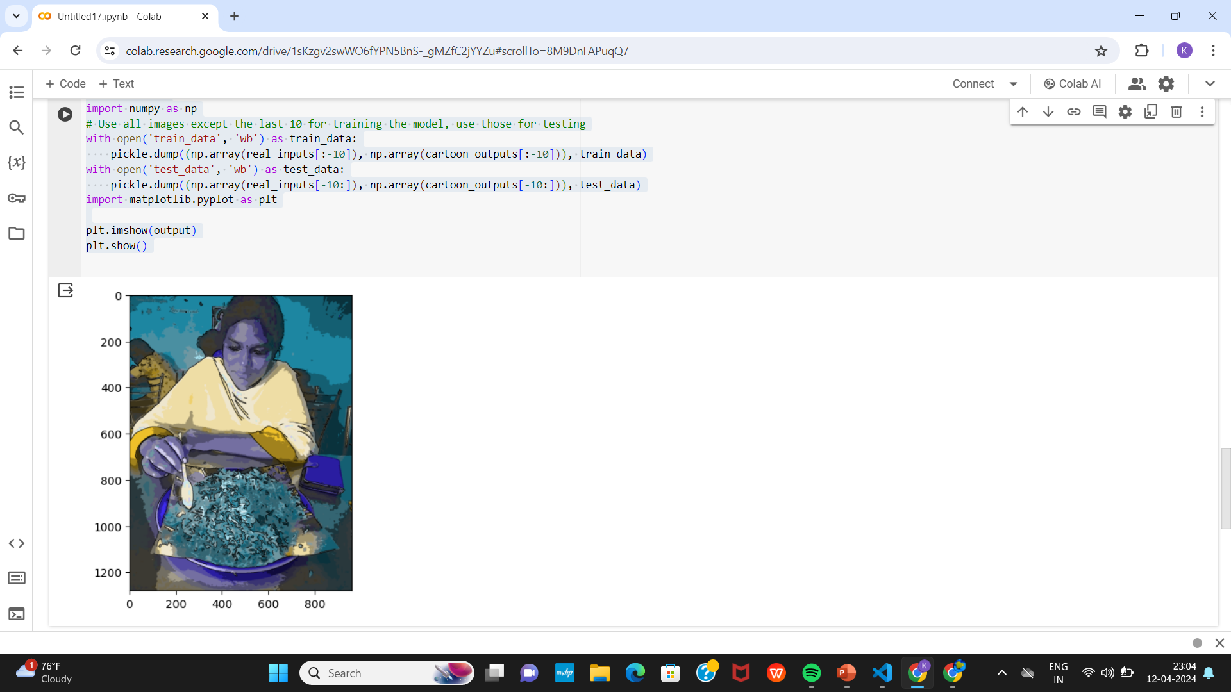
Result

Slide 12
Conclusion
In conclusion, the development of an Image to Cartoon generator using machine learning offers a promising solution for transforming photographs into captivating cartoon-style images.
By leveraging advanced machine learning techniques, such as convolutional neural networks and generative adversarial networks, it is possible to create sophisticated models capable of preserving key features while applying artistic stylizations.
Throughout the development process, key considerations such as dataset collection, preprocessing, model selection, training, evaluation, and deployment play vital roles in ensuring the system's effectiveness and usability. By following a systematic approach and continuously iterating based on feedback and evaluation results, developers can create robust and user-friendly solutions that meet the needs of diverse audiences.
The application of an Image to Cartoon generator extends beyond entertainment and artistic expression, finding practical use cases in industries such as animation, graphic design, advertising, and social media. Furthermore, ongoing advancements in machine learning research and technology hold the promise of further enhancing the quality and versatility of such systems in the future.In essence, the Image to Cartoon generator represents a compelling intersection of art and technology, offering users a novel way to express creativity and transform their visual content into engaging and distinctive representations.

